Slide 1
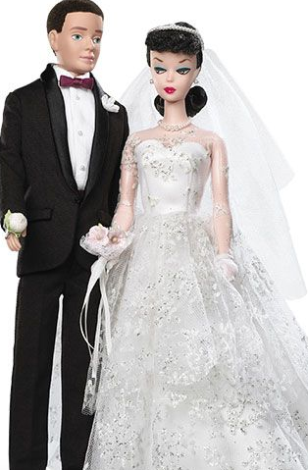
Speed Dating Experiment
What attributes influence the selection of a romantic partner?
Problem:
Analyzing gender differences in dating preferences from final outcome is difficult because a given correlation of attributes across partners is often consistent with underlying preferences.
Hypothesis:
Studying dating behavior using an experimental Speed Dating market where subjects are matched randomly creates variation in the number of potential partners and allows for direct observation of individual decisions rather than just final matches.
Data Set:
In this experimental paradigm, subjects meet a number of potential partners(between 9 and 21) for four minutes each, and have the opportunity to accept or reject each partner.
The main variable of interest is the Yes/No decision of each subject with respect to each prospective partner. This choice is supplemented with valuation of attributes (attractiveness, sincerity, intelligence, fun, ambition, shared interests). A pre-event survey provides additional information on subjects (self-reported) attributes.

Slide 2
Data Exploration Questions
What are the least desirable attributes in a male partner? Does this differ for female partners?
How important do people think attractiveness is in potential mate selection vs. its real impact?
Are shared interests more important than a shared racial background?
Does self-perceived level of attractiveness affect chance of match?

Slide 3
Data Dictionary
Variable | Description | Type
Gender | Female = 0, Male = 1 | Categorical
Match | No = 0 , Yes = 1 | Categorical
Samerace | Participant and partner were the same race: no = 0, yes= 1 | Categorical
Attr | Attractiveness, scale of 1-10 | Categorical
Sinc | Sincerity, scale of 1-10 | Categorical
Intel | Intelligence, scale of 1-10 | Categorical
Amb | Ambition , scale of 1-10 | Categorical
Fun | Funny/sense of humor, scale of 1-10 | Categorical
Shar | Shared interests, scale of 1-10 | Categorical

Slide 4
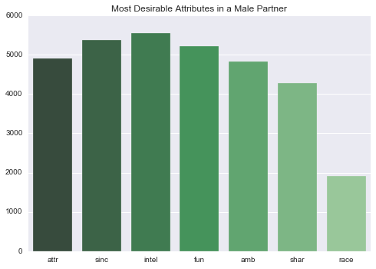
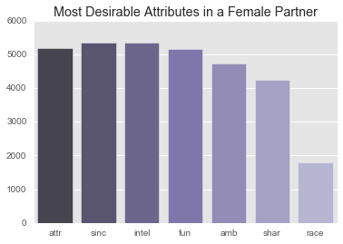
What are the most desirable attributes in a male partner? Does this differ for female partners?

Slide 5
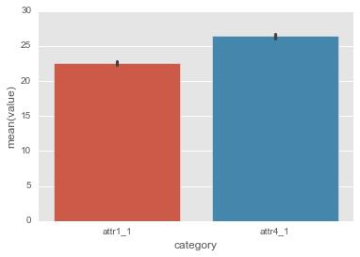
How important do people think attractiveness is in potential mate selection vs. its real impact?
Att1_1: Importance of attractiveness to the participant
Att4_1: How important participant thinks attractiveness is to others

Slide 6
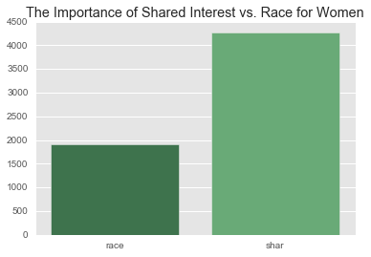
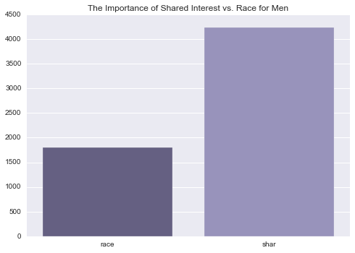
Are shared interests more important than a shared racial background?

Slide 7
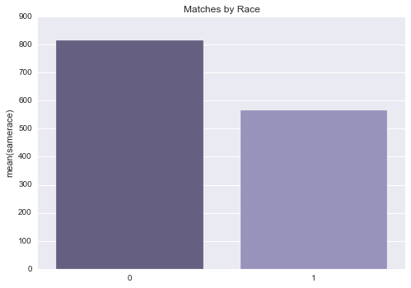
In reality...
Participant and the partner were the same race: 0= No, 1 = Yes

Slide 8
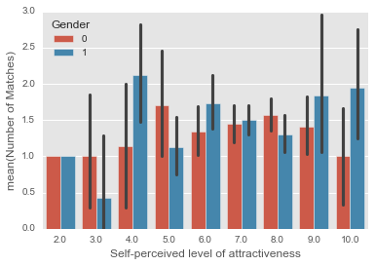
Does self-perceived levels of attractiveness affect chance of matching?

Slide 9
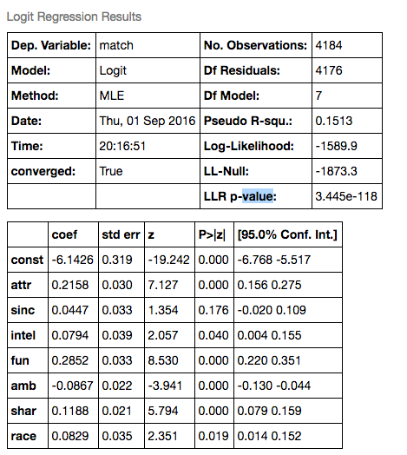
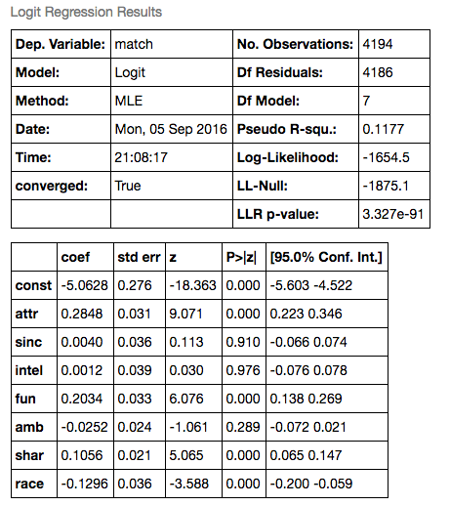
Model: Logistic Regression
Women:
Men:

